Slide 1
WQD7003 – Data Analytic Group Assignment Analysis and Prediction of Crime Statistic in London.
By
Gunasegarran Magadevan - WQD170002
Mathavan Chandrasegaram - WQD17007

Slide 2
4W 1H Question
What :
This is an analytical study to categories the crime and also to produce insight info to prevent or reduce the crime in future.
Why :
To produce valuable and useable insight from historical raw data which may helps to prevent crimes which mostly people get involved
Where :
Raw data of criminal report in London City (UK)
When :
Criminal record from Jan 2008 - Dec 2016
How :
Use few analytical tools to process the raw data and come out with useful insight and prediction.

Slide 3
Overview
We have use data of criminal records happening in London city during Jan 2008 until 2016 to analyze and produce some useful insight from the raw data.
We have categories the crime by month, year, severity of crime, type of most happening crime in city, etc.
This help to focus on the dangerous crime and prevent it moreover it could bring awareness among people around the city.
We also produce visualization of crime based on boroughs (district) of the city and the population against it.
Hence, graph has been plotted on minor crimes against major crimes to show each major category crime among its minor category crime.

Slide 4
Motivation
Currently there are few bodies official and nonofficial teams are working to streamline the crime management processes and to improve current method of crime management.
As such, the outcome of this analysis will enable them to focus on specific problems or area and formulate the targeted solutions

Slide 5
Objective
Aim to produce useful insight by using clustering data analytical.
To visualize crime rate by borough, major category, minor category and populations.
To summaries the top categories of crime by borough and identify top problem spots.

Slide 6
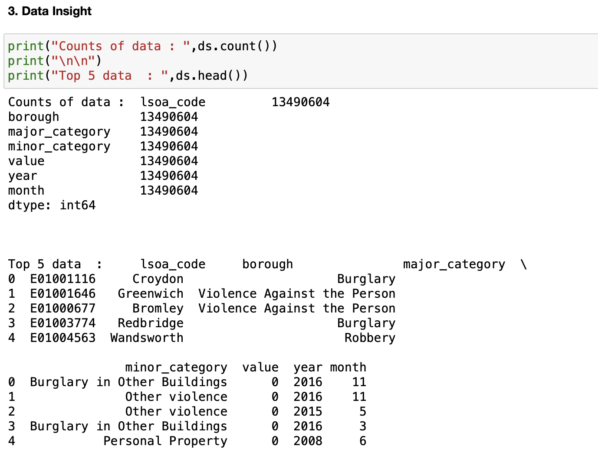
Dataset
The dataset is consisting by 7 variables:
lsoa_code: LSOA in London (United Kingdom)
borough: borough (district) names of in London (United Kingdom)
major_category: categorization of high level crime minor_category: categorization of low level crime
value: monthly reported count of categorical crime in given borough (district)
year: year of reported counts, 2008-2016
month: month of reported counts, 1-12 (January-December)
The variables lsoa_code, borough, major_category, minor_category, year and month are categorical variables, while value is a discrete numerical variable.

Slide 7
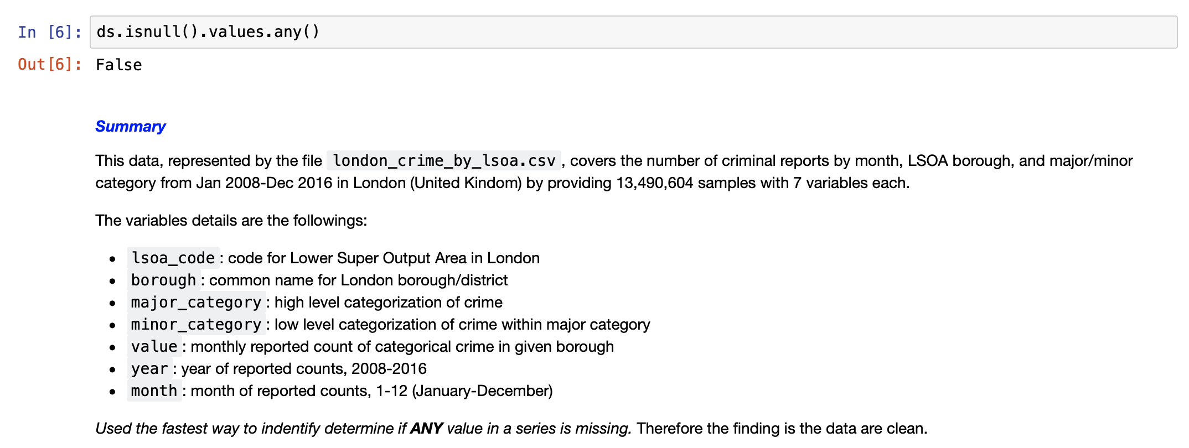
Data Cleaning
From the dataset, we used the used the fastest way to identify determine if ANY value in a series is missing. Therefore the finding is the data are clean.

Slide 8
Quantitative Variables Analysis :
Since 247 unique values of the dataset's samples have the variable value equals to 0.
To conclude, the window of time from 2008 to 2016 was not too compact of criminal activities.

Slide 9
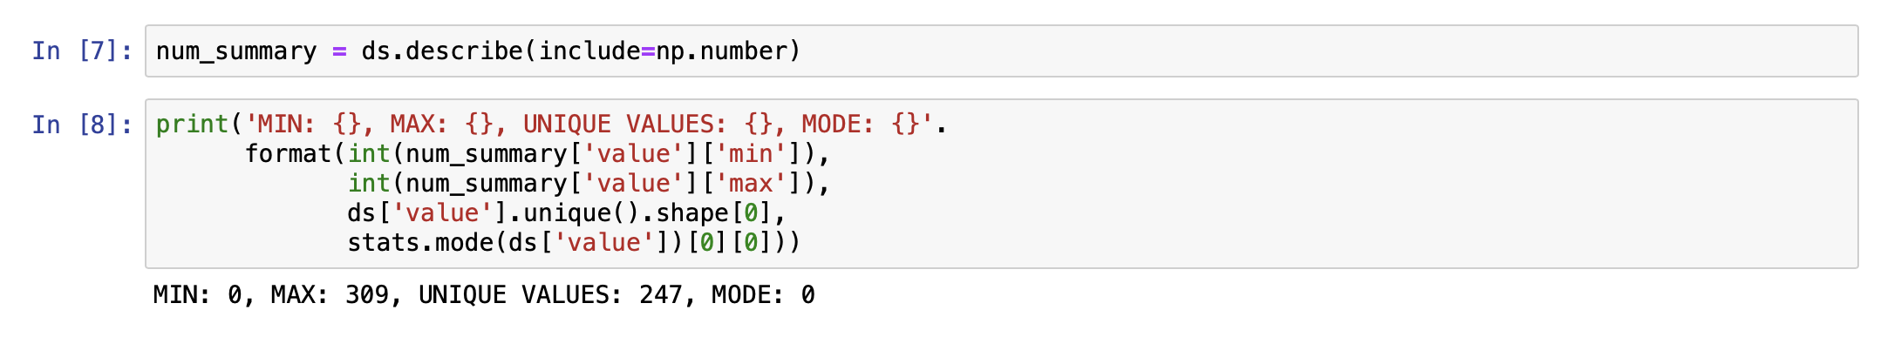
Quantitative Variables Analysis :
1. Since 247 unique values of the dataset's samples have the variable value eguals to 0.
2. To conclude, the window of time from 2008 to 2016 was not too compact of criminal activities.

Slide 10
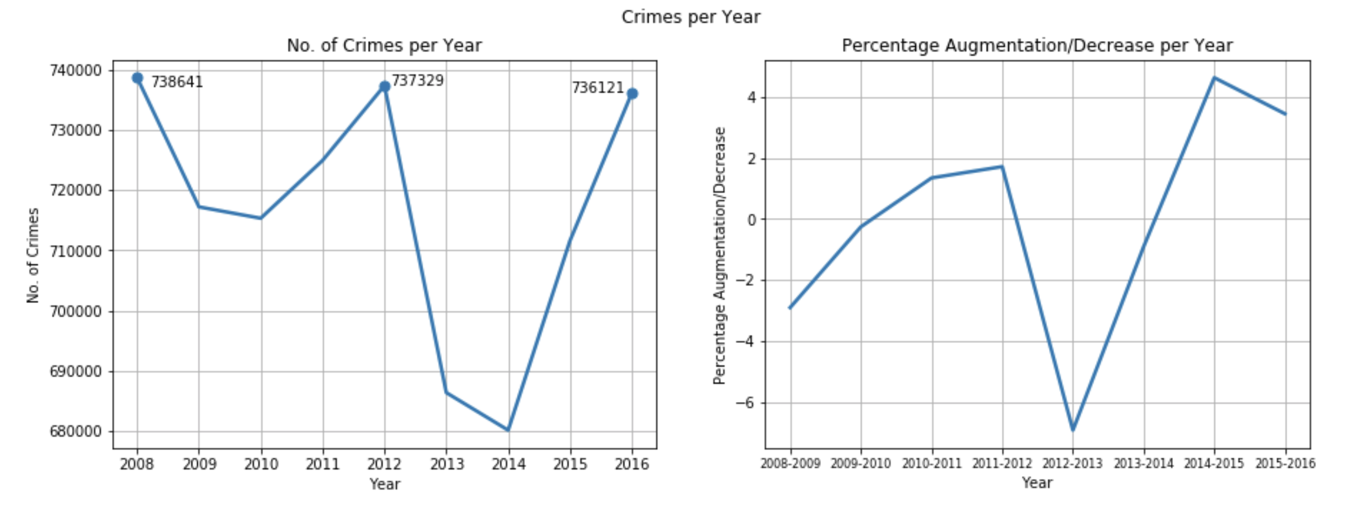
Quantitative Variables Analysis :
The figure above represents the flow of criminal activities on a by yearly basis:
The most criminally decrease year are by year 2008, 2012 and 2016.
The most peaceful year are 2014 and 2013.

Slide 11
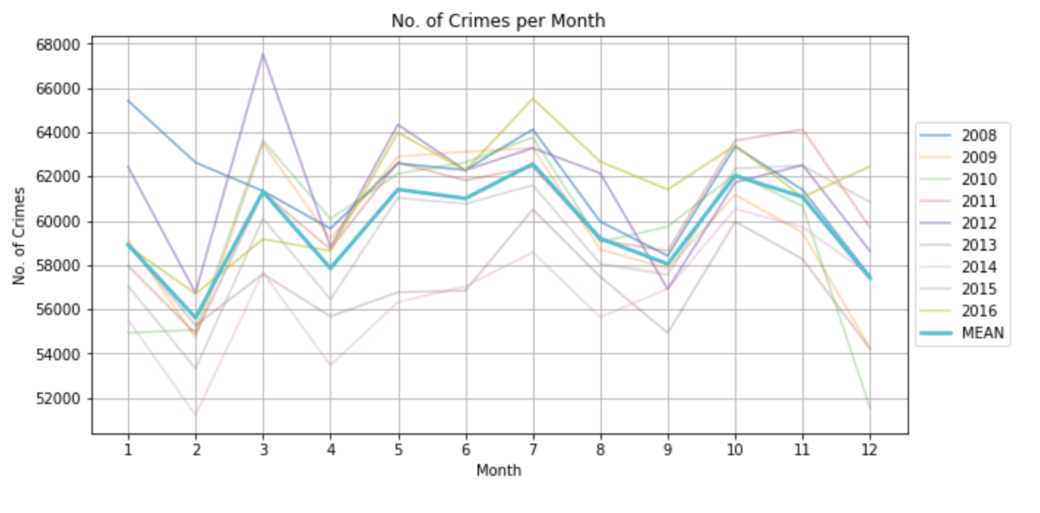
Quantitative Variables Analysis :
The figure above represents the flow of criminal activities on a by month basis:
Observing a behaviour that remains coherent with the flow of criminal activities on a by yearly basis.

Slide 12
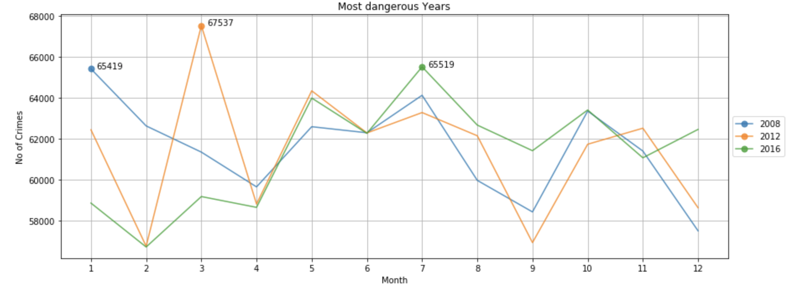
Quantitative Variables Analysis :
The figures above shows the flow of criminal activities on a by month basis for the most decrease years:
By looking at the criminal activities represented in this graphs like a flow, it is unique that the amount of criminal reports have the tendency to increase once every four years.

Slide 13
Categorical Variables Analysis :
The year 2016 rise aside from numerical analysis.
Despite being the least decrease of criminal activities in the top three represented by the years, in descending order, 2008, 2012 and 2016, is the one that owns the majority of the records in the cropped dataset.
It means that, remaining coherent with what rise in the numeric variable's analysis, it has the lower crime per month ratio among the three.

Slide 14
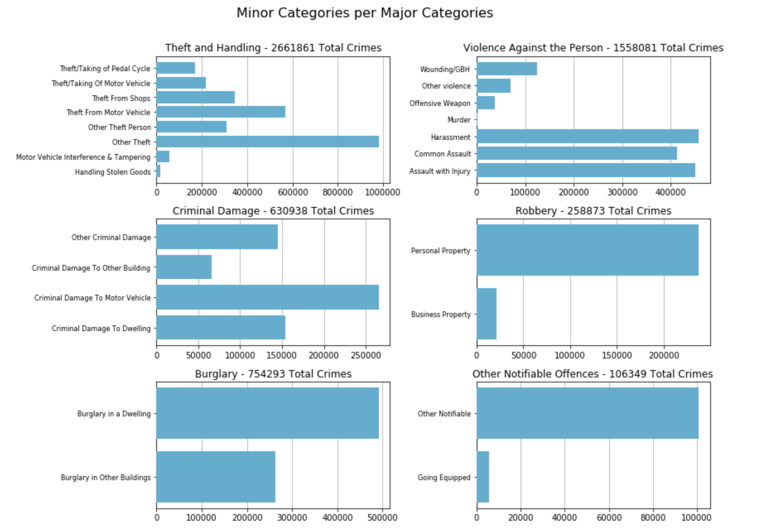
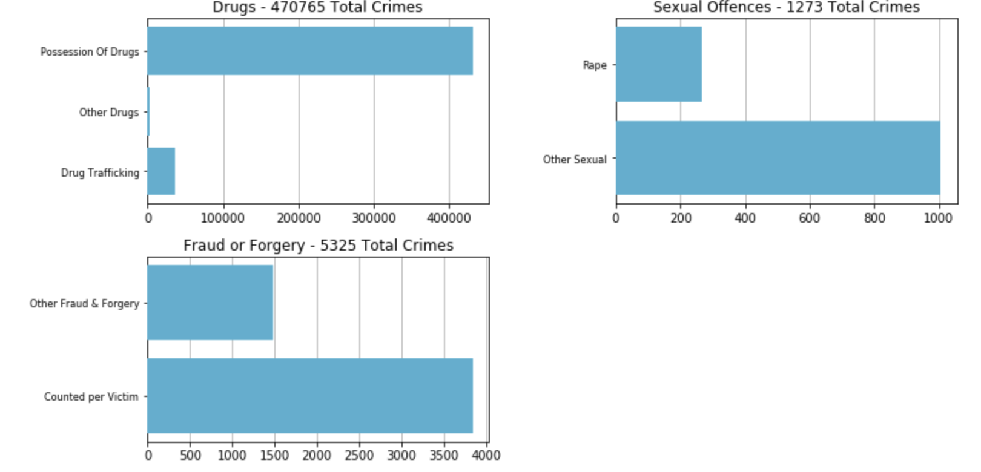
Categorical Variables Analysis :

Slide 15
Categorical Variables Analysis :
The minor category crimes classification is very rich, with Theft and Handling being the most diversified with eight minor categories.
The subclass of the total number of criminal activities for each major category crime among its minor categories.
By observing the graphs it is possible to extract the most frequent minor category for each major category:
Theft and Handling -> Other Theft
Violence Against the Person -> Harrasment
Criminal Damage -> Criminal Damage To Motor Vehicle
Robbery -> Personal Robbery
Burglary -> Burglary in a Dwellingv
Other Notifiable Offences -> Other Notifiable
Drugs -> Possession Of Drugs
Sexual Offences -> Other Sexual
Fraud or Forgery -> Counted per Victim

Slide 16
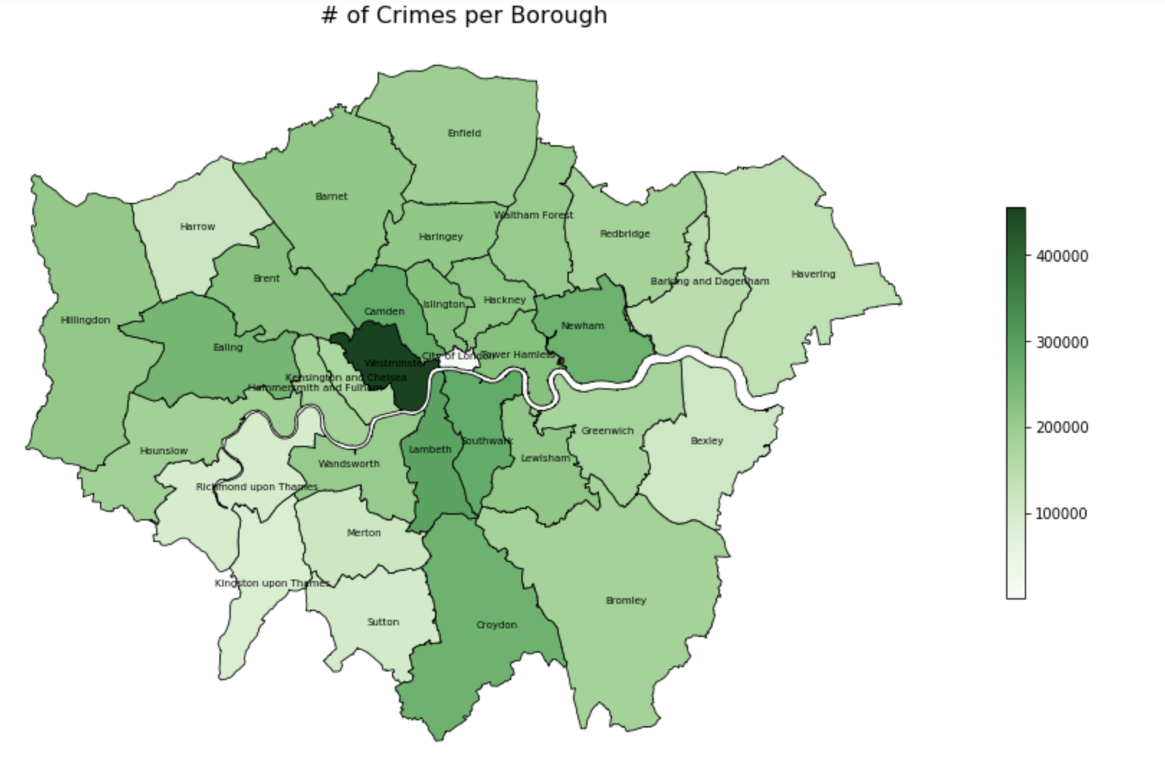
Categorical Variables Analysis :

Slide 17
Categorical Variables Analysis :
From the geographic visualization proves what has been discovered so far.
Westminster is confirmed as the most decrease of criminal activities among the boroughs, while City of London is confirmed as the least dense of criminal activities.
The naive assumption that there is no correlation between the number of crimes committed during the window of time proposed by the dataset and the boroughs territorial extension.

Slide 18
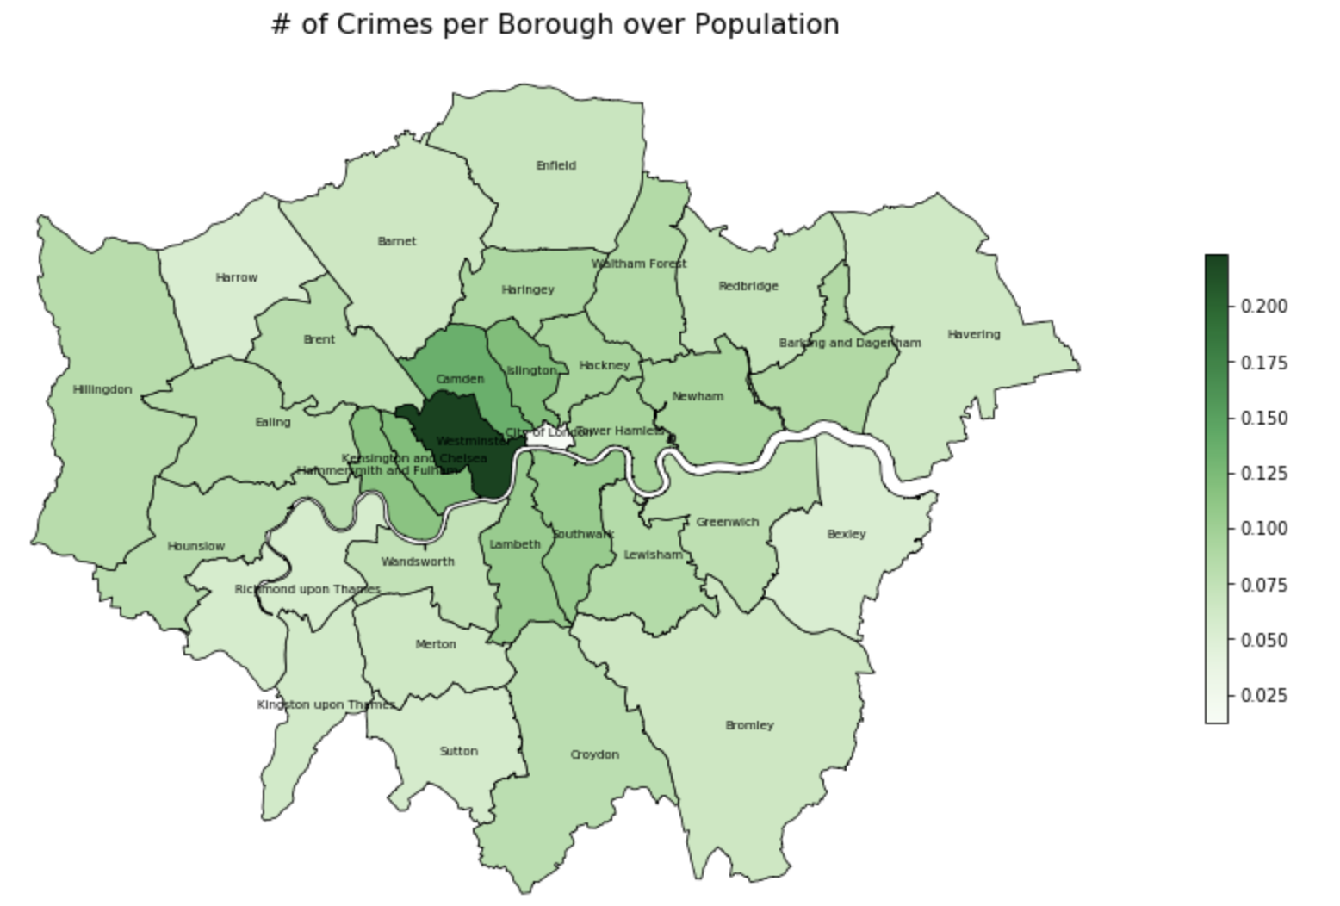
Categorical Variables Analysis :

Slide 19
Categorical Variables Analysis :
This visualization shows a general very low score for the ratio between the number of crimes committed in a district and its population.
This means that, for a certain window of time, the number of criminal activities are fewer than the population density - in a way confirms the fact that the period of time investigated by the dataset is a quite safe window of time.

Slide 20
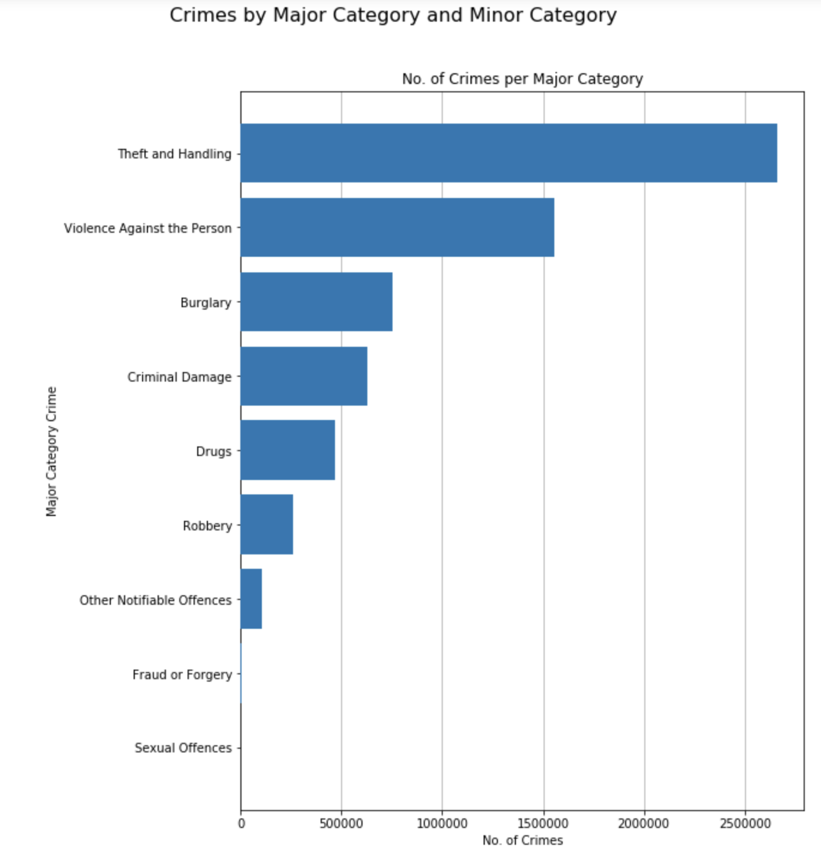
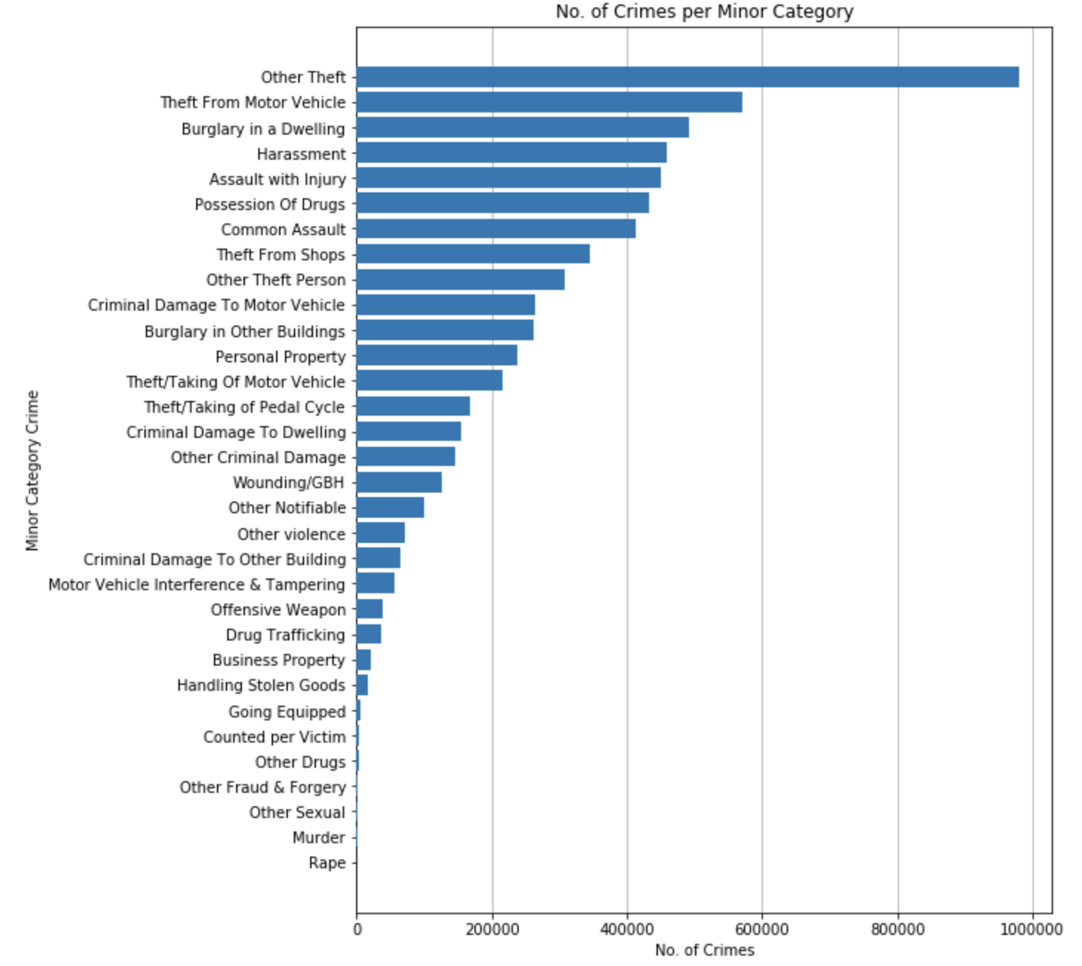
Categorical Variables Analysis :

Slide 21
Categorical Variables Analysis :
Despite being Lambeth the most popular borough among the cropped dataset's records, the most dangerous is actually Westminster, as depicted in the visualizations.
Theft and Handling is the most frequent major category crime and Other Theft is the most frequent minor category crime.

Slide 22
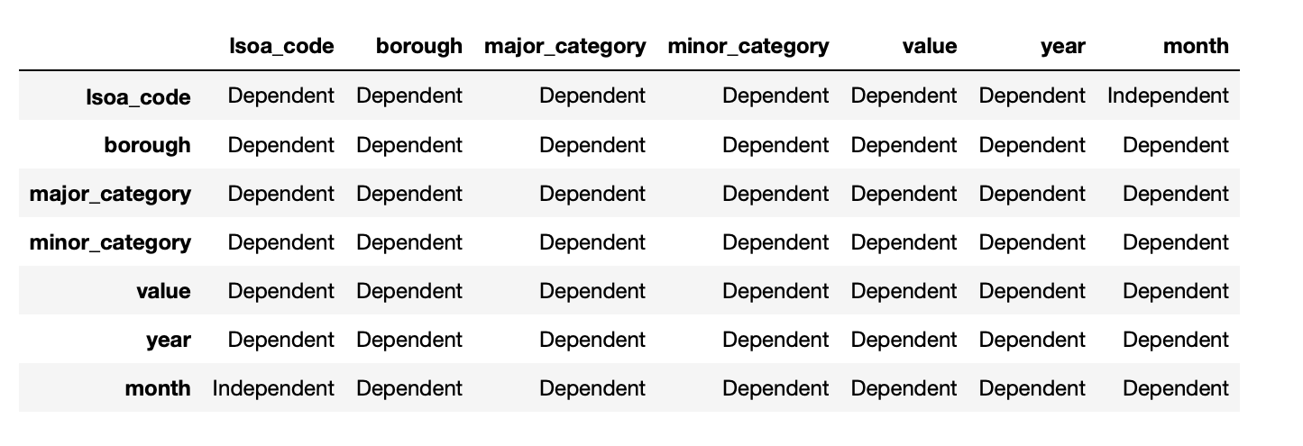
Correlation
The results returned by the correlation analysis are not surprising as expected.
The dataset is composed by a set of variables that are all depending on each other.
In the correlation table above, the majority of variables have a relation with the other variables that can be classified as dependent, while the variables lsoa_code and month are classified as independent.

Slide 23
Conclusion
Lambeth the most popular borough among the cropped dataset's records.
The most dangerous is actually Westminster, as depicted in the visualizations.
Theft and Handling is the most frequent major category crime and Other Theft is the most frequent minor category crime.
The variables in datasets are all depending on each other, the majority of variables have a relation with the other variables that can be classified as dependent, while the variables lsoa_code and month are classified as independent.

